Slide 1
‘Planting The Right Tree in The Right Place’

Slide 2
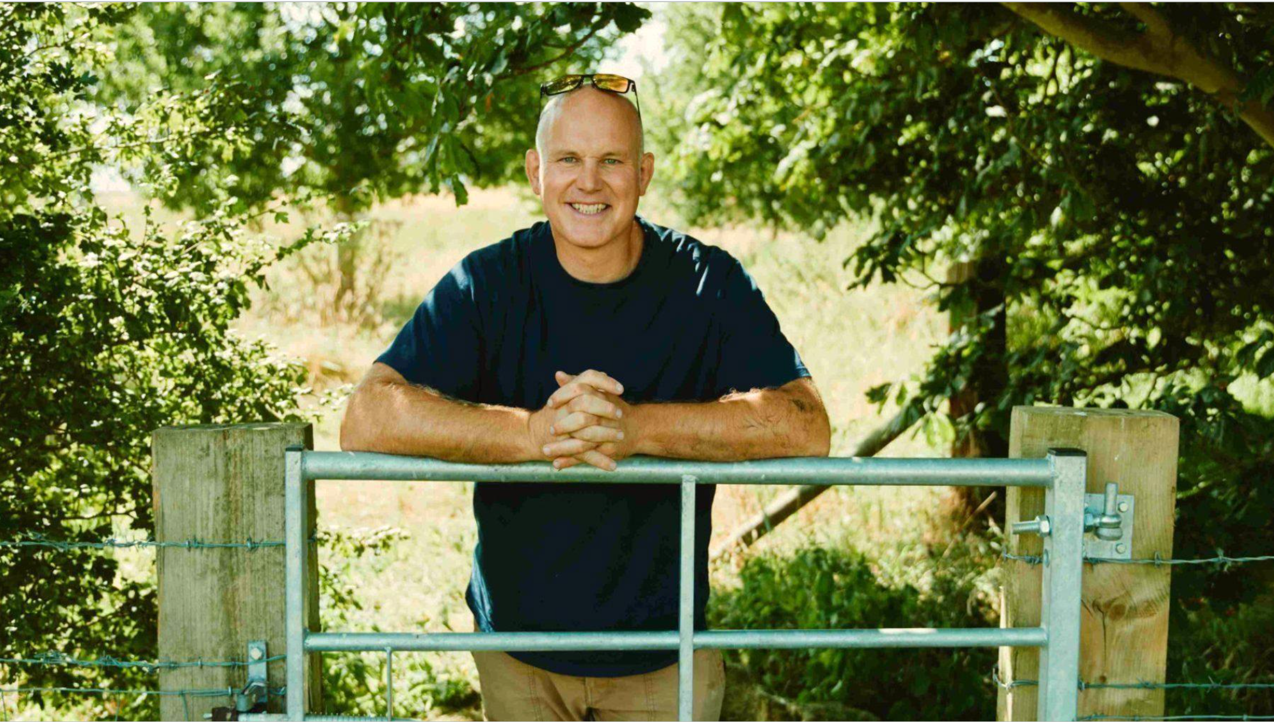

Slide 3
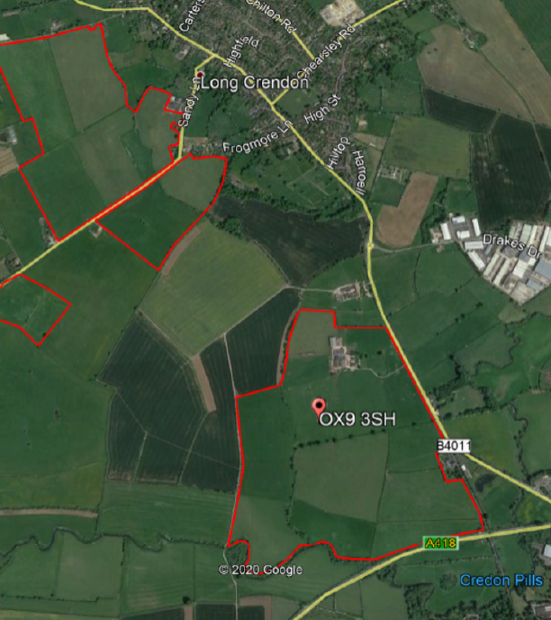
Redding’s Farm
Lopemede Farm
Notes:
Who Am I
Ed Rixon
Manage J Rixon Ltd comprising two farms;
Reddings Farm in Long Crendon
Lopemede Farm in Thame
Both farms are permanent pasture and we have a mixture of cattle and sheep on the farm.

Slide 13
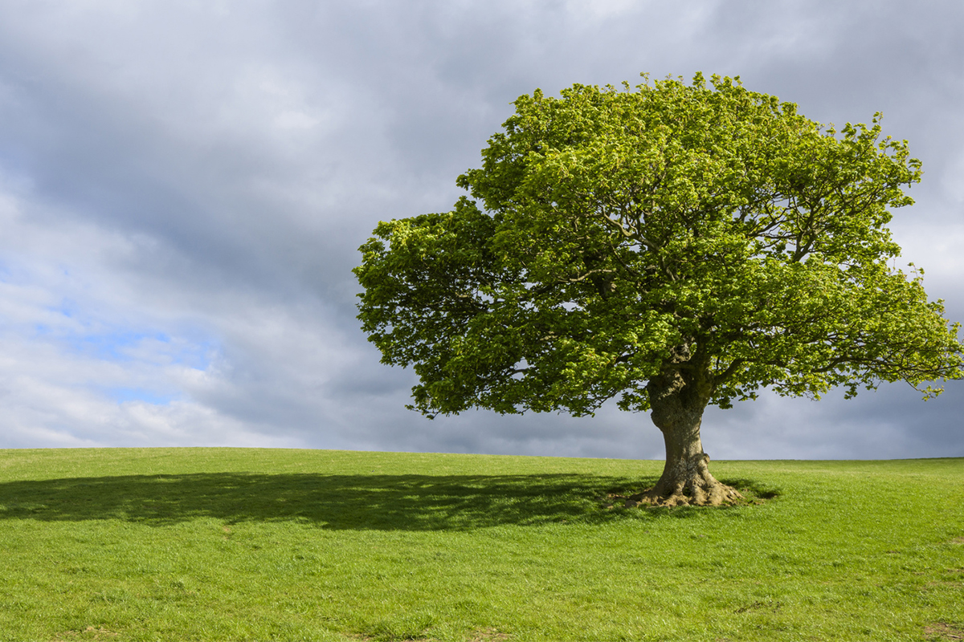
Why I am interested in trees
What I’m doing on our farms to grow trees
Why we need to grow more trees
What trees should we be growing
What tools can we use to aid tree selection

Slide 14
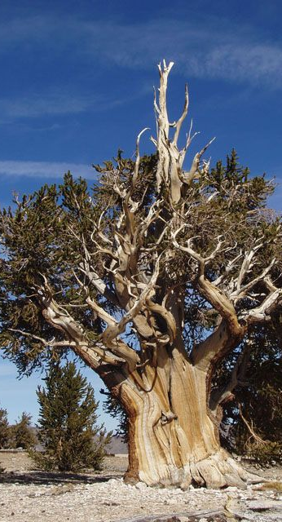
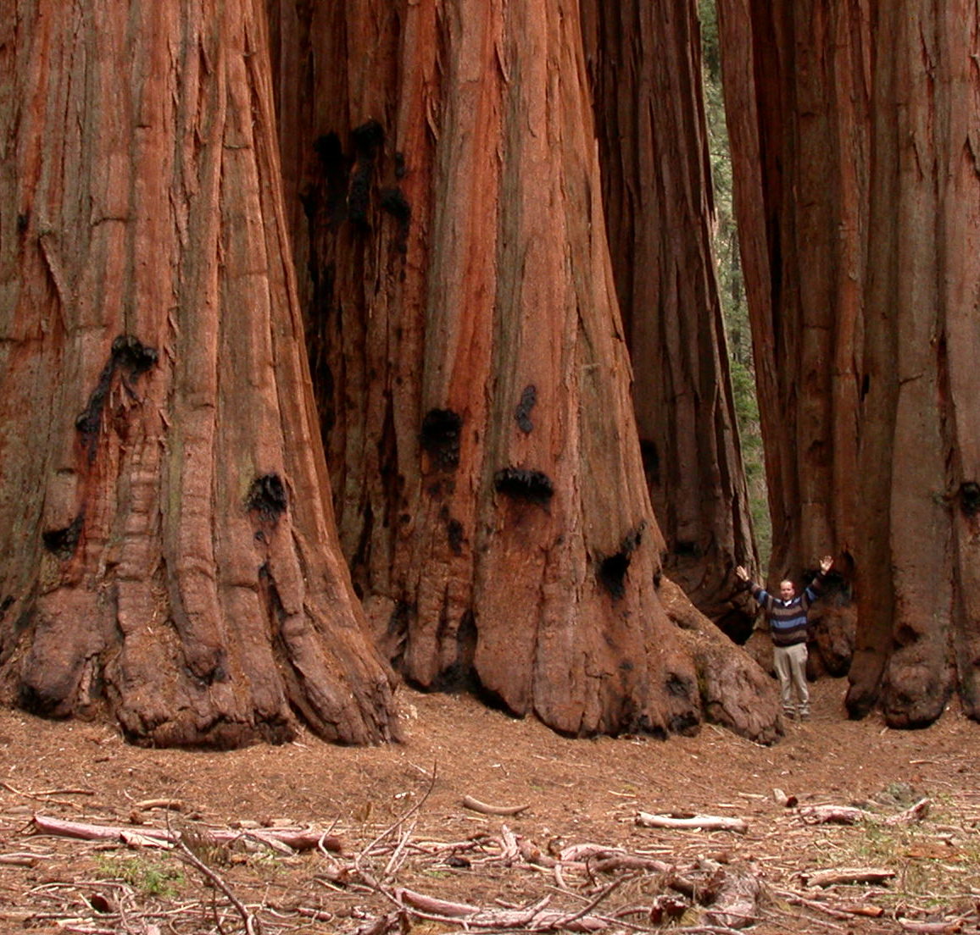
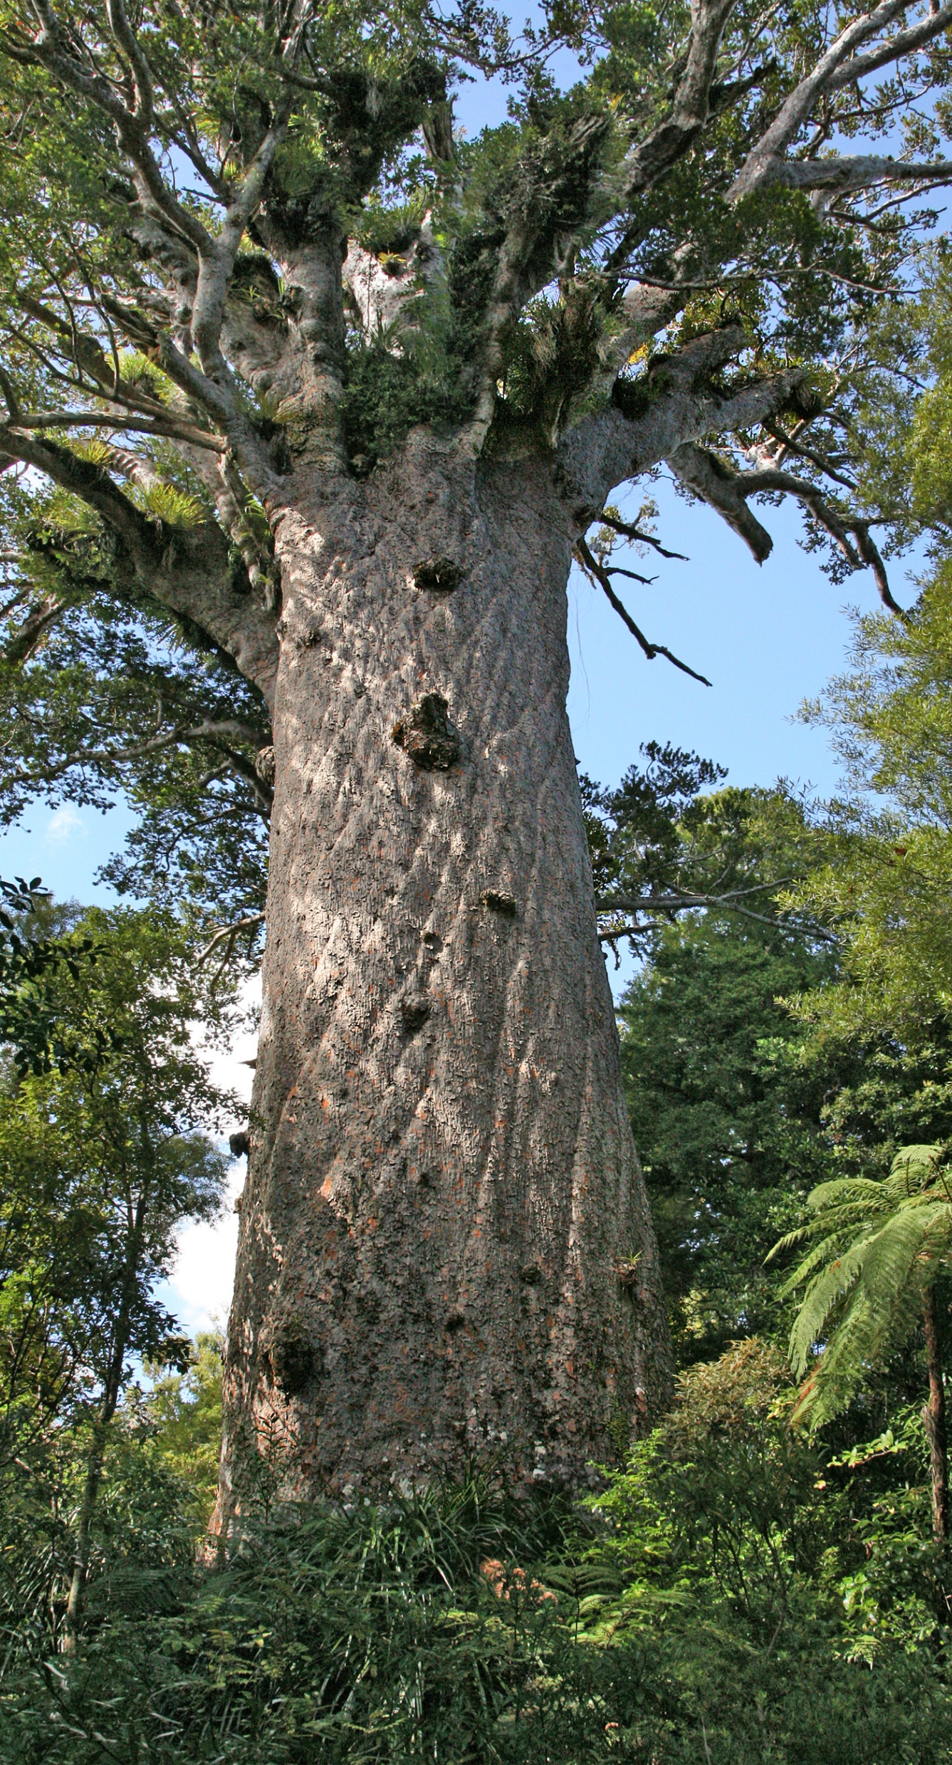
Notes:
So you maybe wondering why I am here to talk about growing trees; well I’ve always had a fascination with trees since an early age visiting many famous species from around the world whilst on holiday, from the Bristle cone pines of California which are reputed to be the oldest living organisms in the world at over 5,000 yr olds, to the giant sequoia trees also of California also being very long lived and reaching massive sizes, and the spiritual Kauri tree Tane Mahuta in New Zealand which know as the god of the forest

Slide 15
Why am I interested in Growing Trees @ Lopemede Farm?
UK Agricultural has entered a historic transition
Exiting the EU and the removal of subsides and the movement to Environmental Land Management (ELMS) and away from (BPS)
Alignment with the government commitment to net zero emissions by 2050
For shade and shelter for livestock, and for helping the biodiversity and climate crisis.
Creating a more resilient landscape
Notes:
But my interest in growing trees, was reignited due to the change in the UK agricultural policy following the exit of the EU. UK farming subsidies will be completely removed over the course of the next 7yrs and in 2024 will be replaced with a new UK Agricultural policy called Environmental Land Management (ELMs), whereby funding will be available for the planting of trees.
The government wants to incentivise the planting of trees, as they are a central pillar to the governments commitment to being net zero for emissions by 2050, with the governments stated aim to establish 30,000ha of new woodland every year in England from 2020 to 2025.
Therefore, with the loss of funding from subsidies which currently equate to 60% of most UK farms profits it was therefore essential that I explore how I can incorporate the growing of trees into our farms and what this NEW strategic direction could mean.

Slide 17
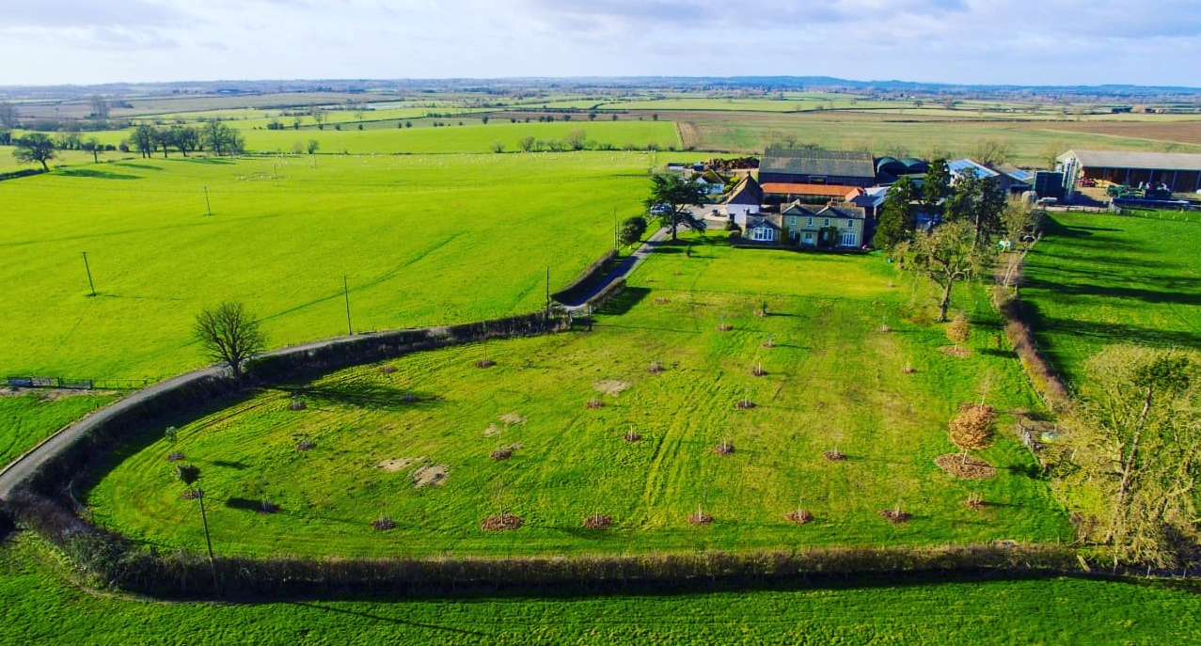
Notes:
So in 2019 we planted a 2 acre paddock into an arboretum whereby we planted 40 different species to understand what trees would perform best on our soils.

Slide 18
Open Grown Trees
Notes:
The First component of our tree planting strategy is to establish open grown trees across 100ha in the grazing platform, so this won’t inhibit our ability to grow beef and lamb, but will provide a variety of benefits.
A key benefit of open-grown trees is that they are allowed to reach full size at maturity, developing full crowns and a wide, natural limb structure that will create a larger area for carbon sequestration and habitat for wildlife. Open grown trees also generally get the opportunity to fulfil their natural lifespan and grow into post-maturity to become ancient and veteran trees..

Slide 19
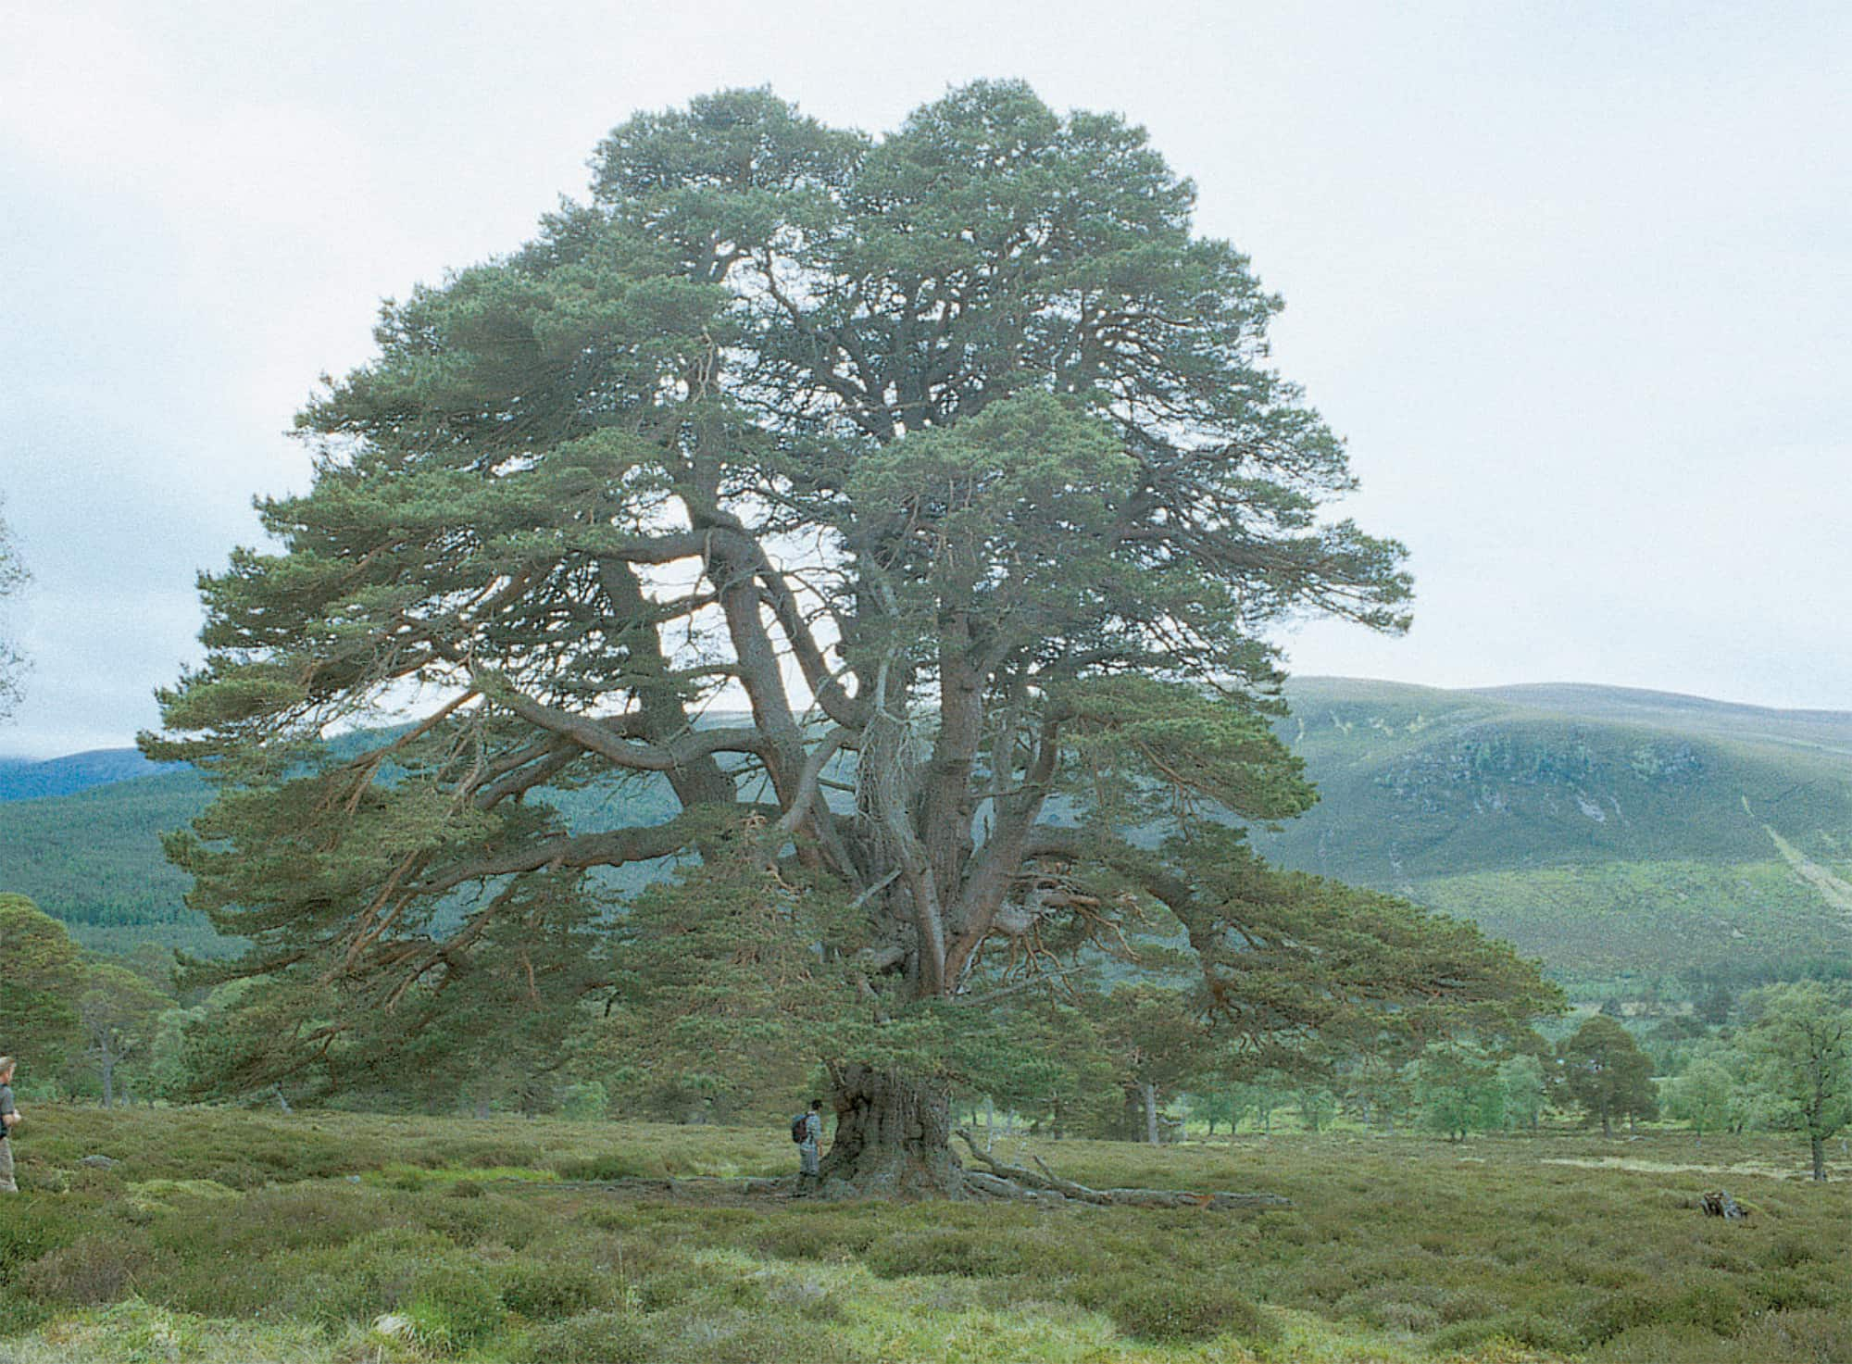
Notes:
Here is a great example of an open grown Scots Pine, one of our most light demanding native trees

Slide 20
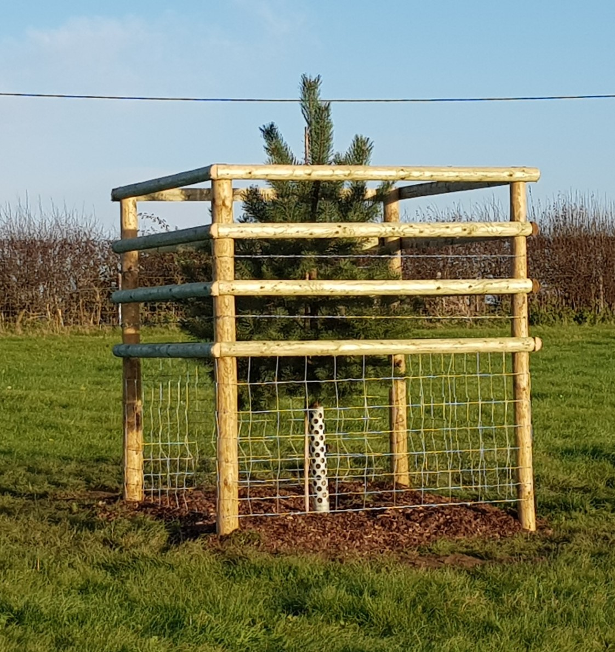
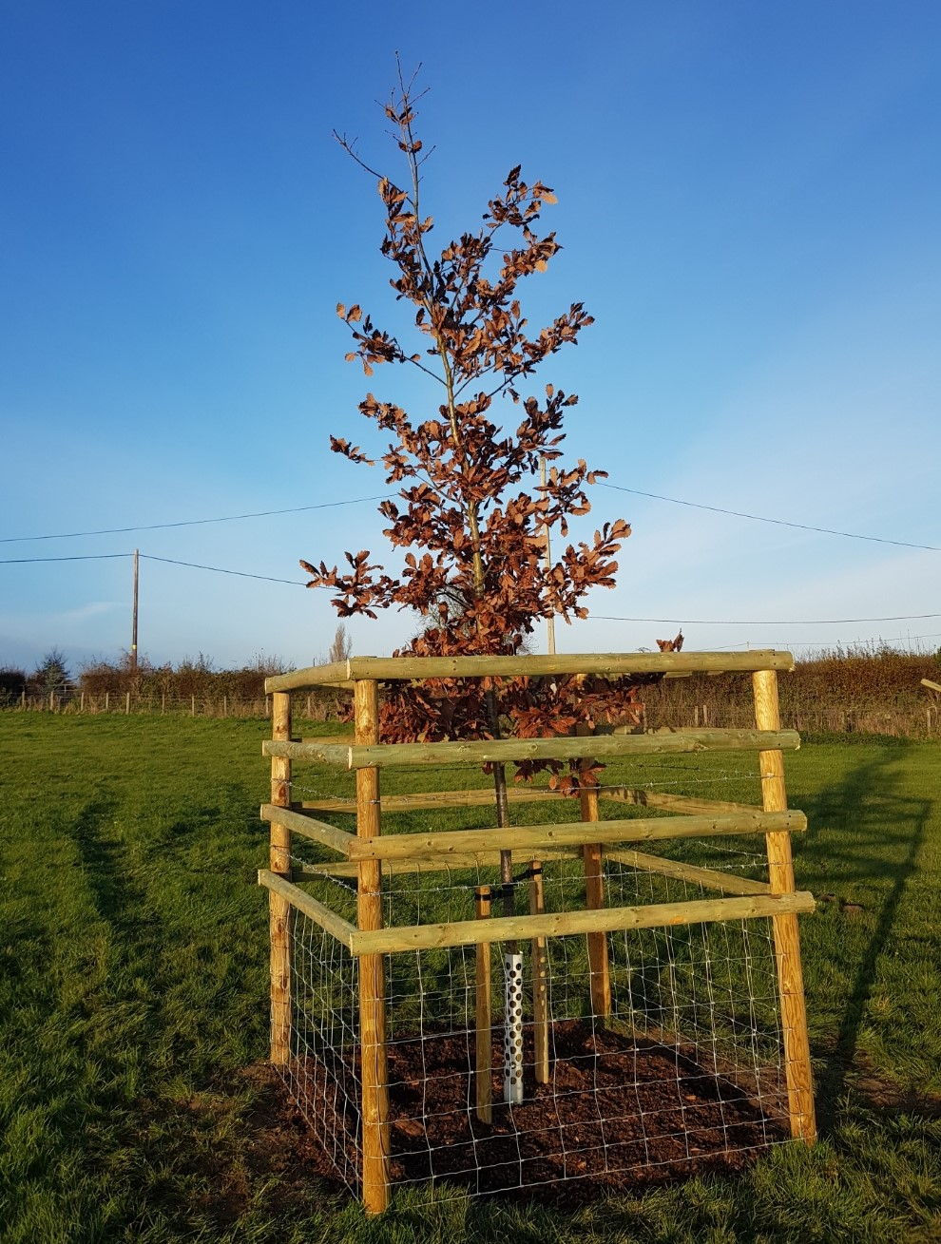
Open Grown Trees
Notes:
We start growing planting trees last November as you can see in the photos here. It is essential that we protect each tree with adequate protection from livestock. We have also used standard trees, rather than whips because
Better landscape-scale impact
2. Shorter time before trees provide shelter for livestock
3. Trees will deliver greater environmental benefits in a shorter time frame
The downside to planting standard sized trees is the maintenance requirements for the first 3 years, especially regular watering through the spring and summer.

Slide 21
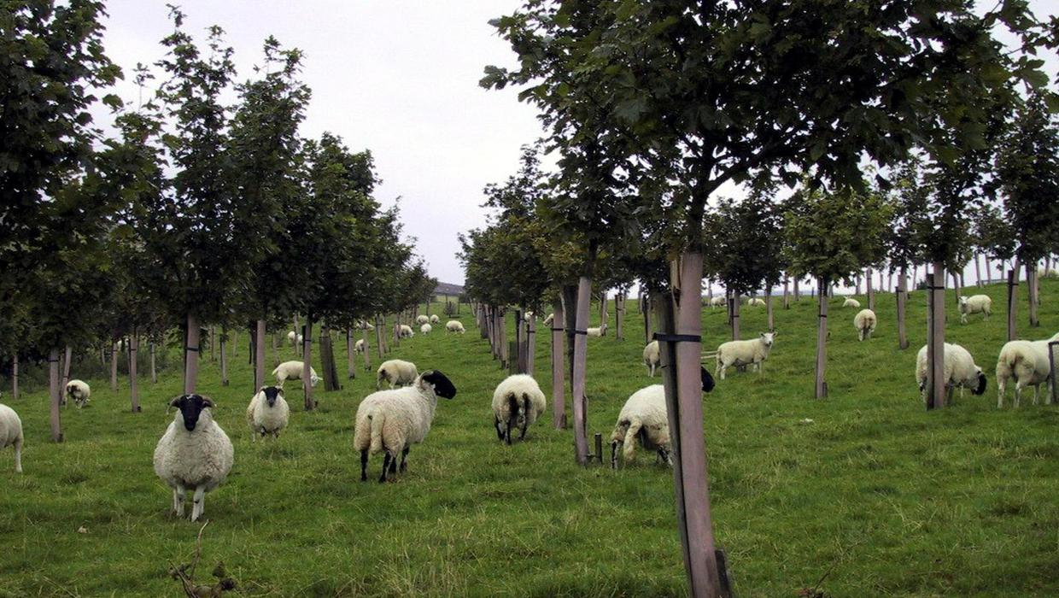
Agroforestry
Notes:
The third part of growing trees on the farm is to established rows of fruits trees within the a number of fields to grow, local heritage varieties of apples, pears, cherries, nuts, and potentially also to grow trees for coppicing on a 5 year cycle, for the production of biomass chips for boilers for heating, or the production of compost. The purpose of this aspect is to gain an additional crop from the field, which can be sold, such as apples, cider, nuts, cherries etc.

Slide 22
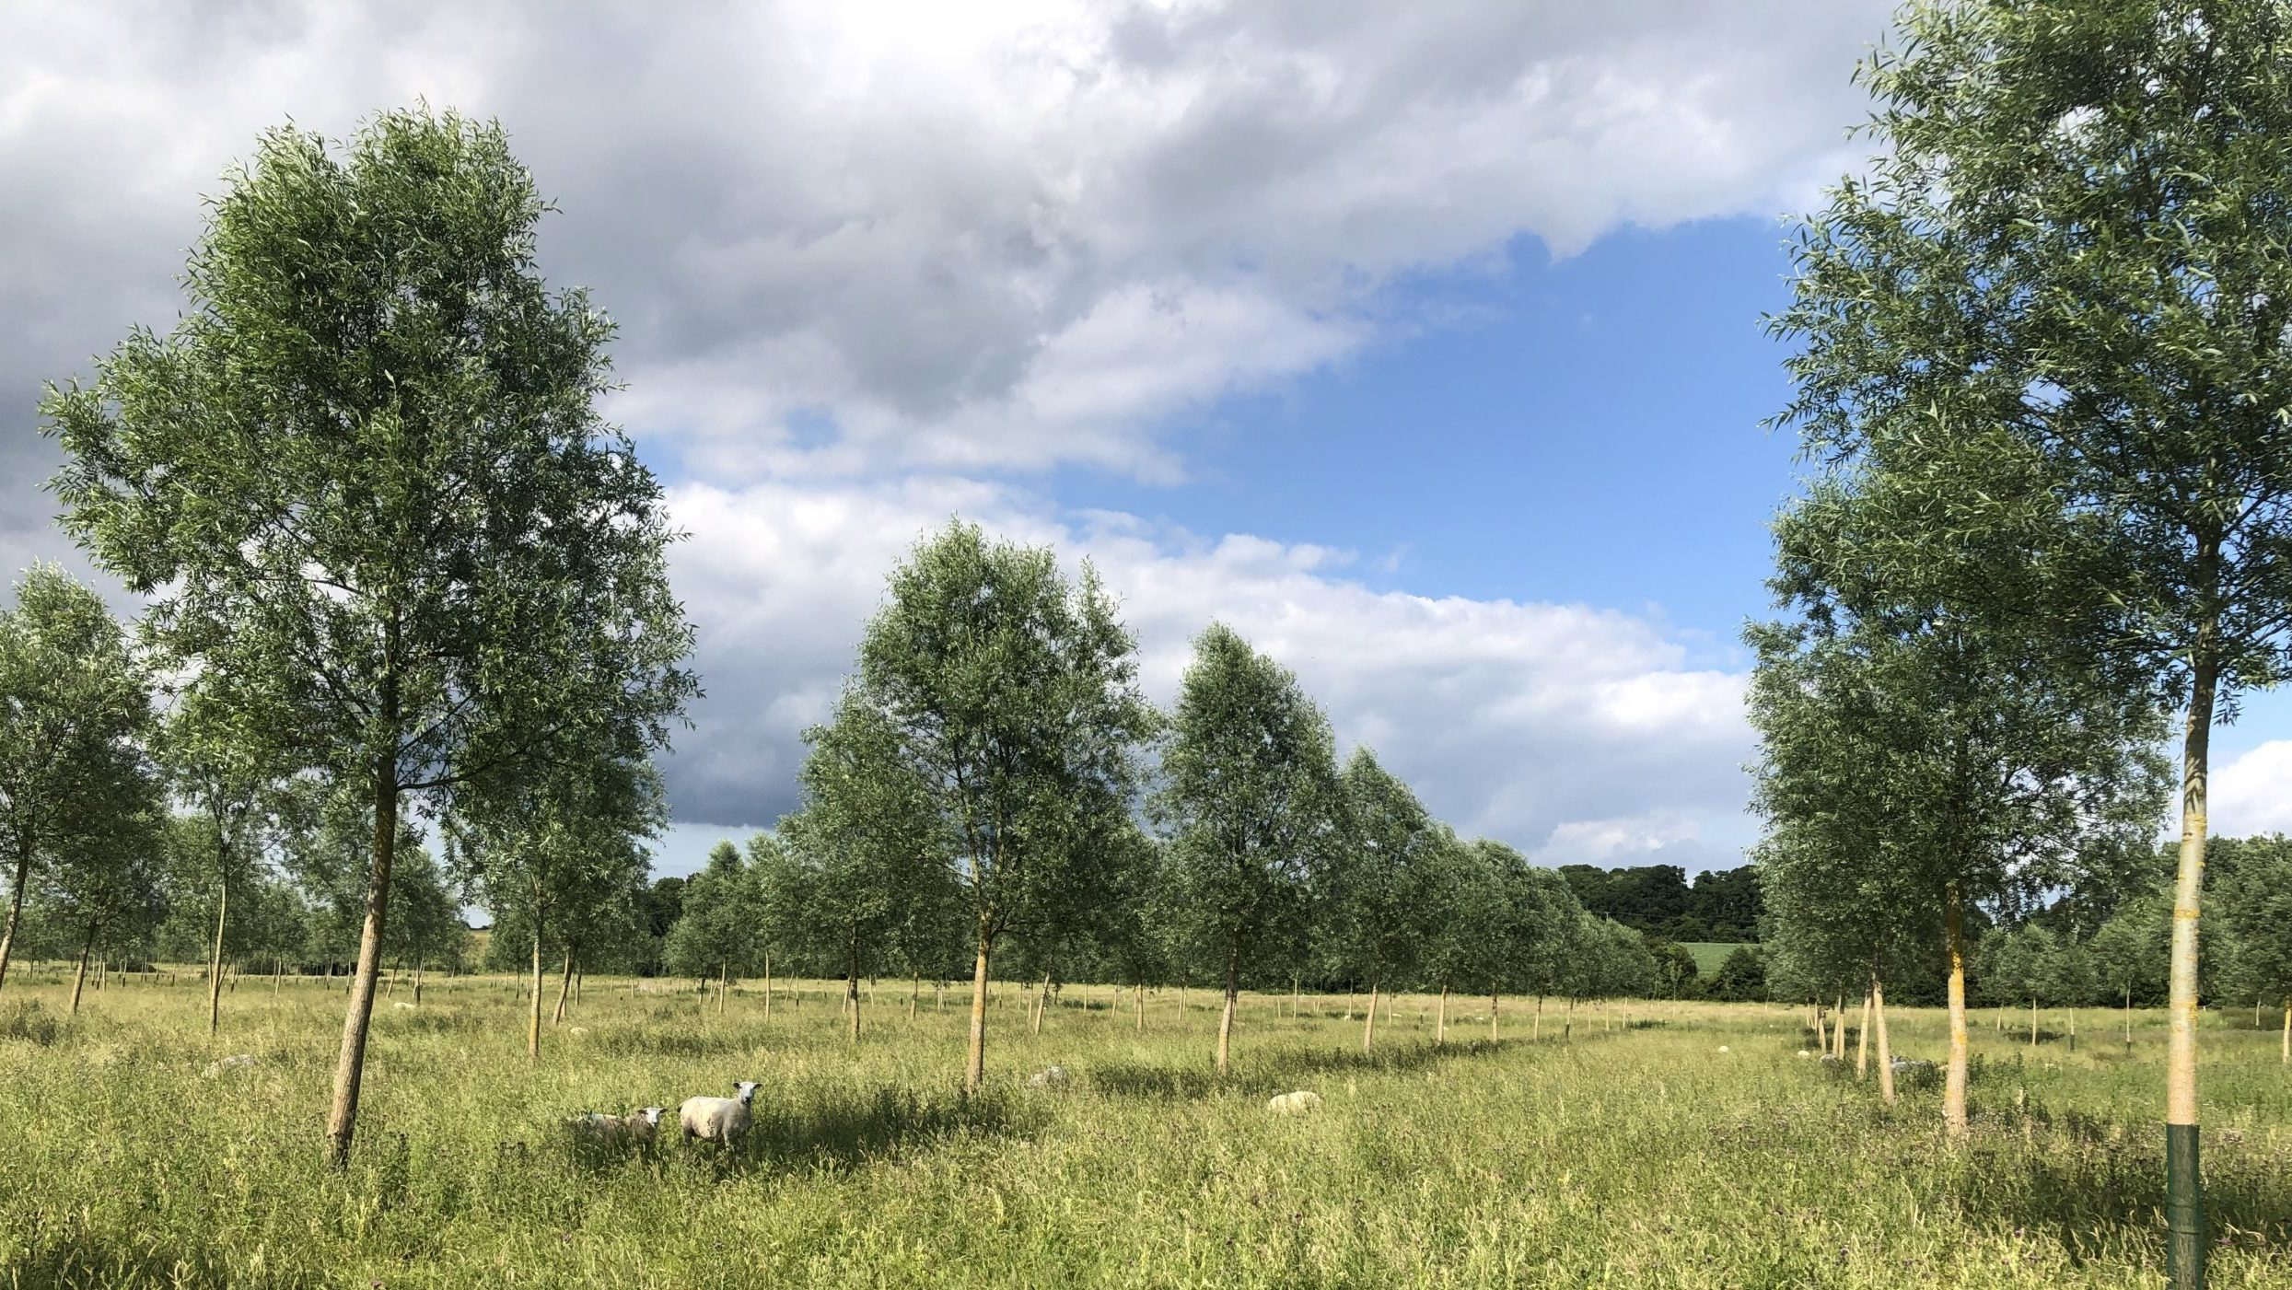
Cricket bat willows
Notes:
A further example of agroforestry is growing cricket bat willows as a cash crop,, as we have a number of wet river fields which would be well suited to growing trees within. The market for growing cricket bat willows is high, due to the growing export demand from India and Pakistan for UK cricket bats.

Slide 23
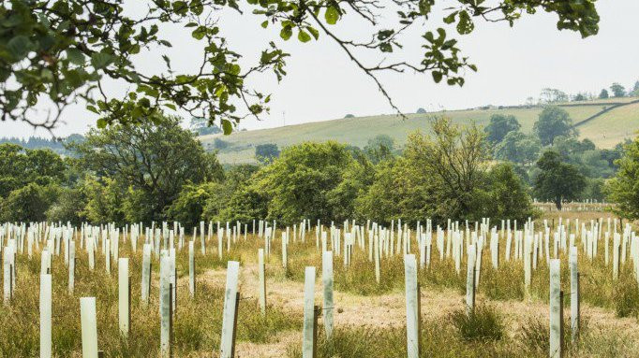
Woodland Creation
Notes:
The final part of growing trees will be the creation of woodland, where we have outlying or unproductive fields.

Slide 24
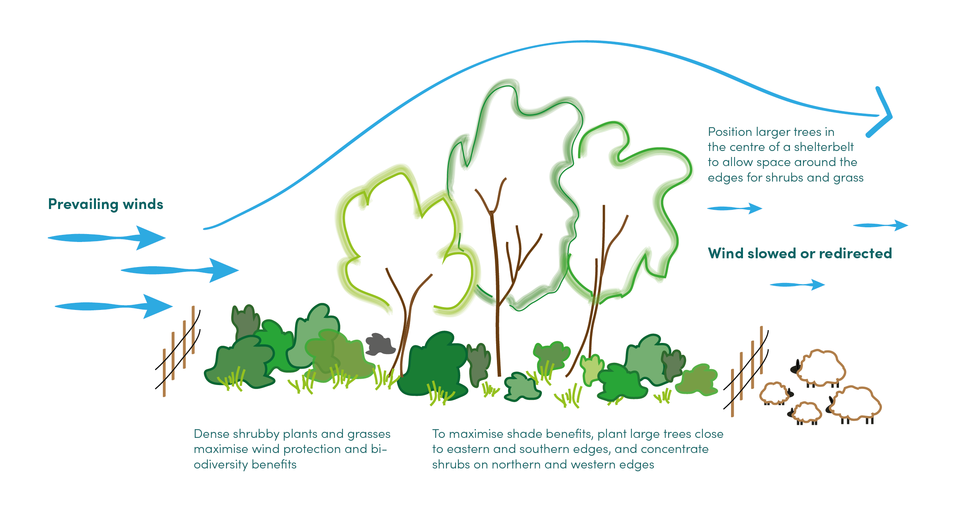
Shelter Belts
Notes:
The second part of growing trees on the farm is to provide shelter belts against the prevailing wind, to provide protection from the wind, as well as being a a great sequester of carbon and a wildlife habitat.

Slide 26
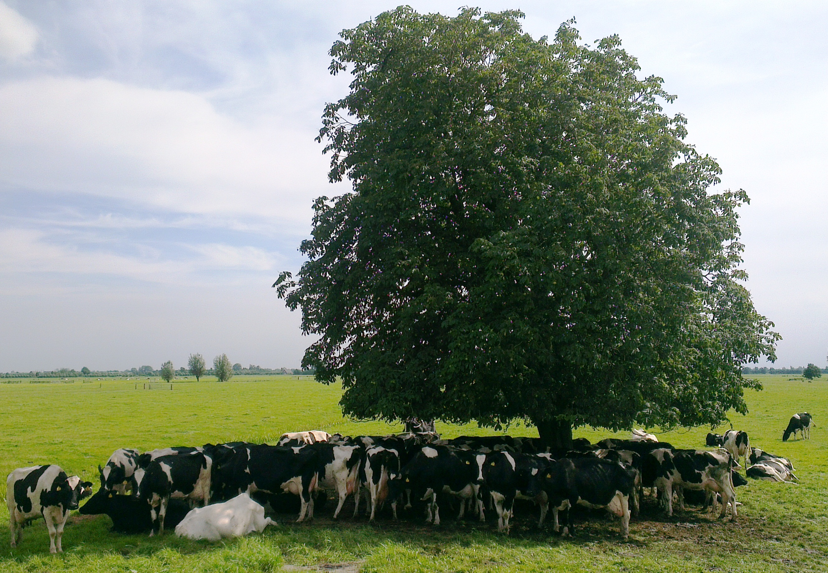
The Benefits of Growing Trees on a Farm?
Improved biodiversity and habitat creation
Reduce soil erosion
Reduced rainwater run-off
Carbon sequestration
Healthier livestock providing shade under trees
Ability to keep stock outside for longer

Slide 27
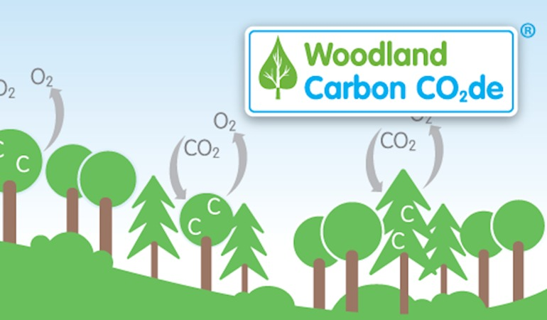
Selling Carbon Sequestered or for insetting Our Woodland Creation Project will generate 5,000 WCU
Notes:
A further benefit to growing trees will be selling the carbon that the trees sequestered, via the government funded department called the Woodland carbon code. Currently the market for selling carbon is in its infancy, however the feeling is that once it becomes compulsory for business to off set carbon, the market for carbon will increase, and in turn so will the planting of trees.

Slide 28
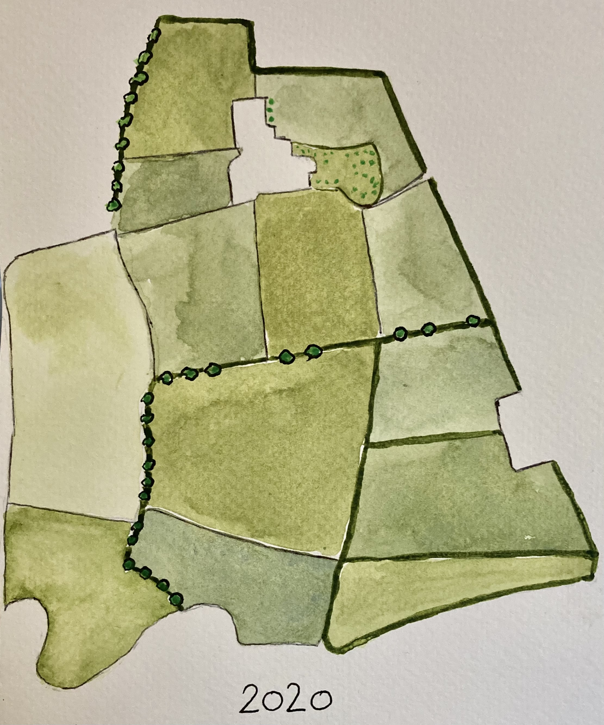
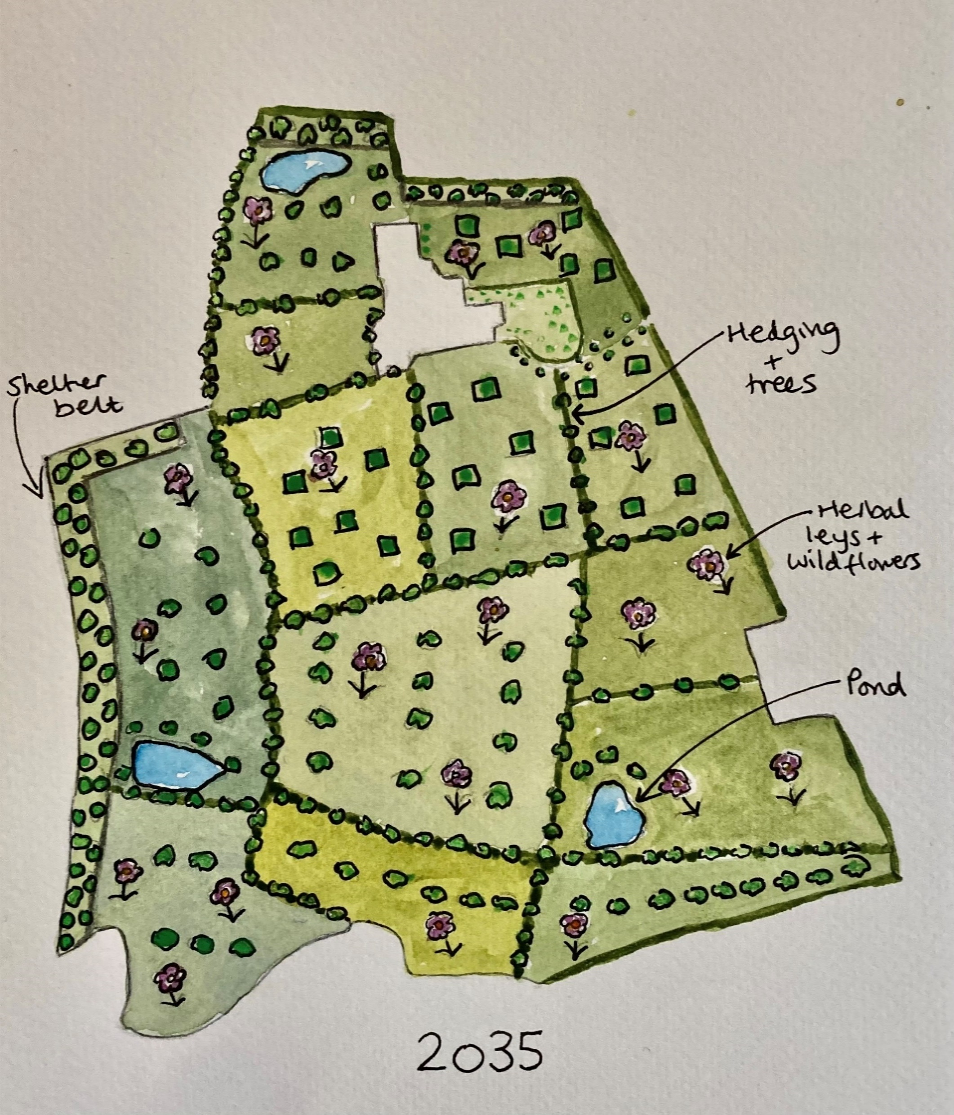
LOPEMEDE FARM
Notes:
So after 15yrs of restoration Lopemede Farm for example should be transformed as illustrated as shown here.
After pulling together the NEW strategic direction for our farms, I decided to increased my knowledge of trees by studying for a degree in Arboriculture and tree management, which I started last year at Myerscough college which is part of the University of Central Lancashire. My intention once qualified as a tree consultant is to help other farmers and landowners with the management of trees on their land.

Slide 29
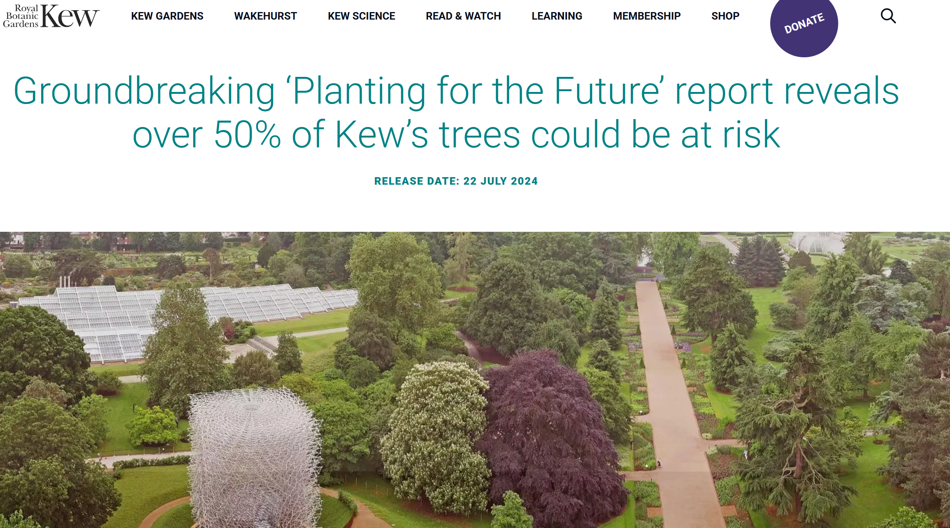
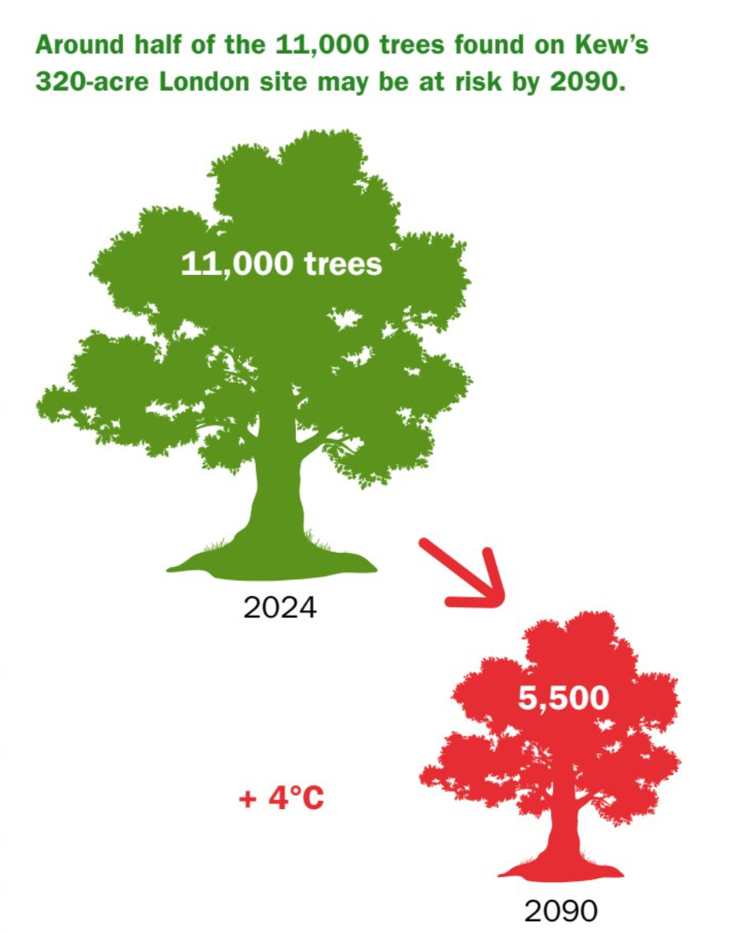

Slide 30
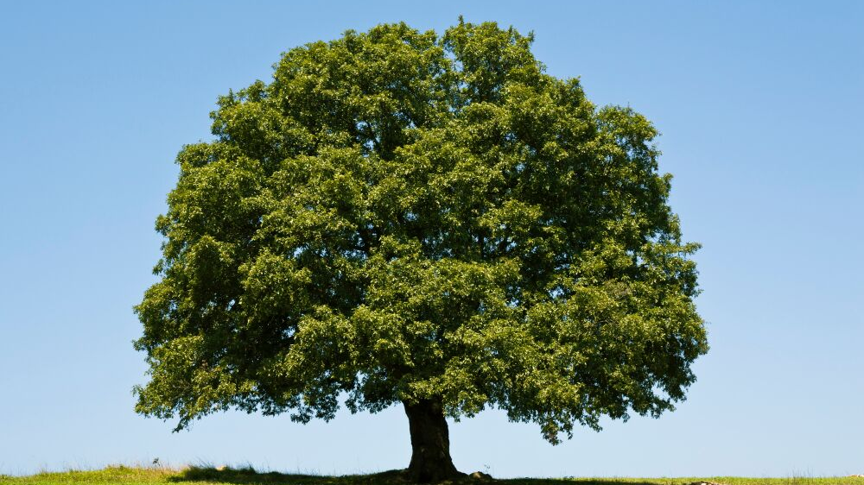
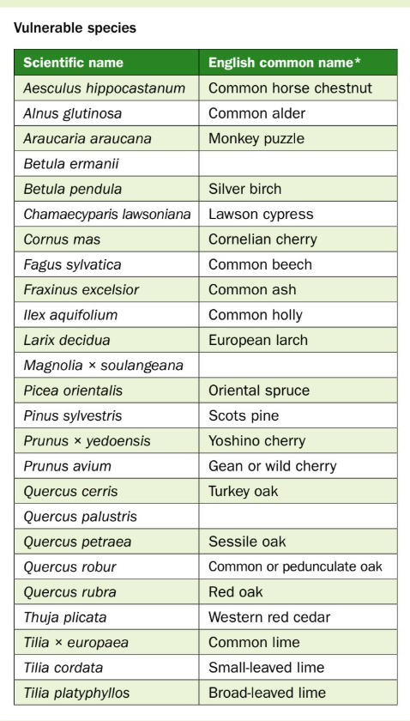

Slide 31
Why we need to grow trees
%
Notes:
Growing trees can help provide a powerful weapon in climate change, as well as reducing emission significantly. The graphs here clearly documents that we are moving towards living in a warmer climate . Whilst trees will not solve the climate emergency on there own they are excellent for carbon capture as woods and forests absorb atmospheric carbon and lock it up for centuries. They do this through the process of photosynthesis.
The UK the government if committed to increasing the UK’s woodland cover from 14.5 to 16.5% equivalent to 30,000 ha / yr

Slide 32
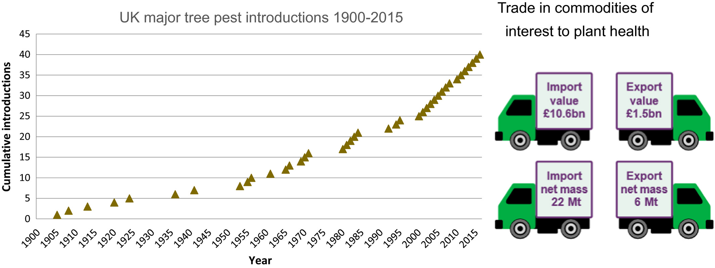
What Trees should we be growing?
Notes:
As the UK is getting warmer we need to think about what trees should be grown, as our specie selection decisions should be based on our future climate, not what it is now. In addition we need to be very mindful to think about specie diversity as the number of tree pests and diseases that are being introduced into the UK is continuing to rise as shown by the graph here, as a direct consequence of the importation of 22mt of plant products into the UK every year, and the increased global movement of people, who unfortunately bring back cuttings and plants products from abroad, without thinking of the consequences to our biosecurity…
Therefore it is important that we plant a wide diversity of species to build resilience to tree populations , and avoid a diseases like Ash Die Back taking out a large percent of our native trees., as Ash trees account for 20% of UK trees, and current concern is that 90% Of all Ash trees will die in the next 30 yrs. .

Slide 33
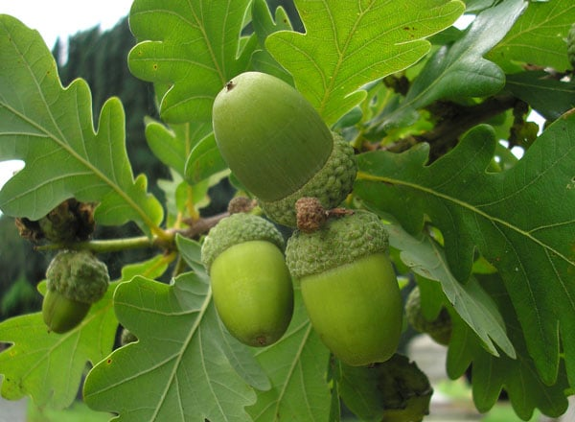
What Species Should we be Growing in the UK?
Notes:
There is currently two views on what species that we should be planting in academia.
Firstly the planting of exotic trees that are physiologically adapted to be more tolerant to key environmental stressors, such as shade, drought and waterlogging.
Secondly planting native trees from seed sourced from the Mediterranean region, to mimic the environmental conditions that the UK is projected to experience by 2050. The attached map here shows the distribution for Quercus robur, the English Oak, so some nursery’s are starting to think about bringing in seed from the south of France
It is also important that we think of the wide range of benefits that native trees provide to our wildlife, that exotic species do not in the same regard. For example the English Oak is a habit for a staggering 2300 species ... not including all of the fungi or any of the bacteria and other micro-organisms

Slide 34
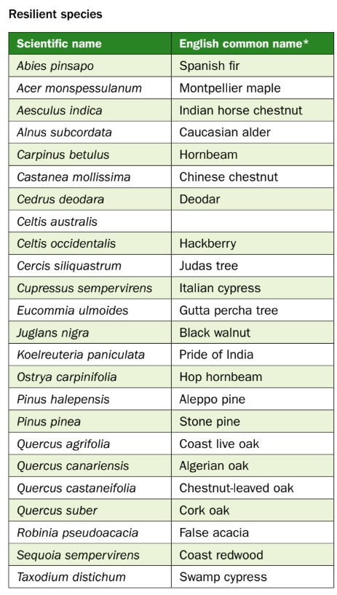
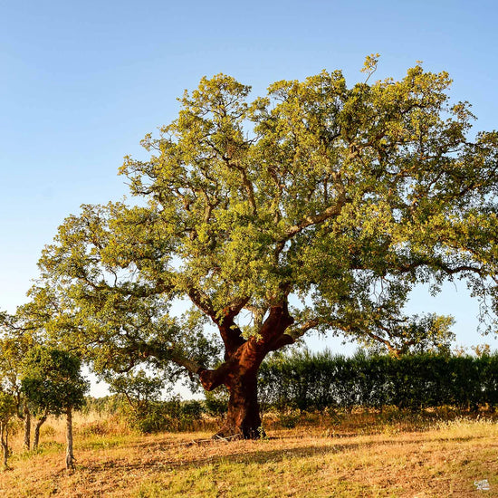

Slide 35
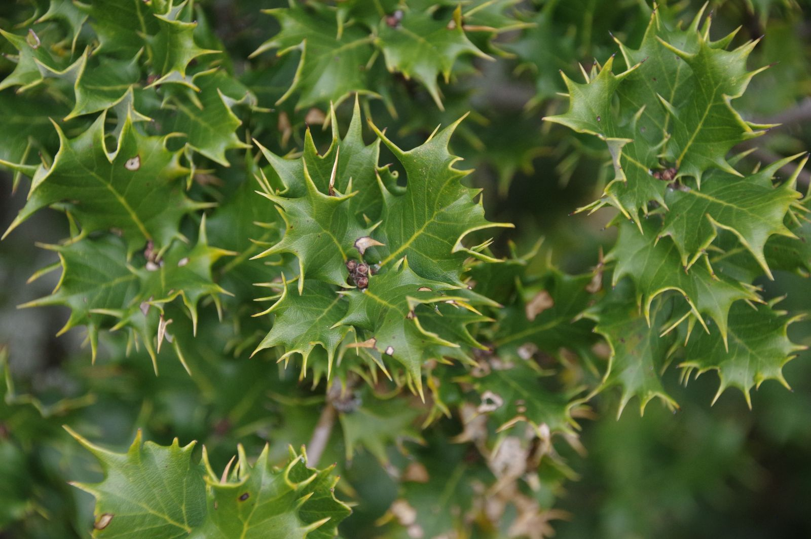
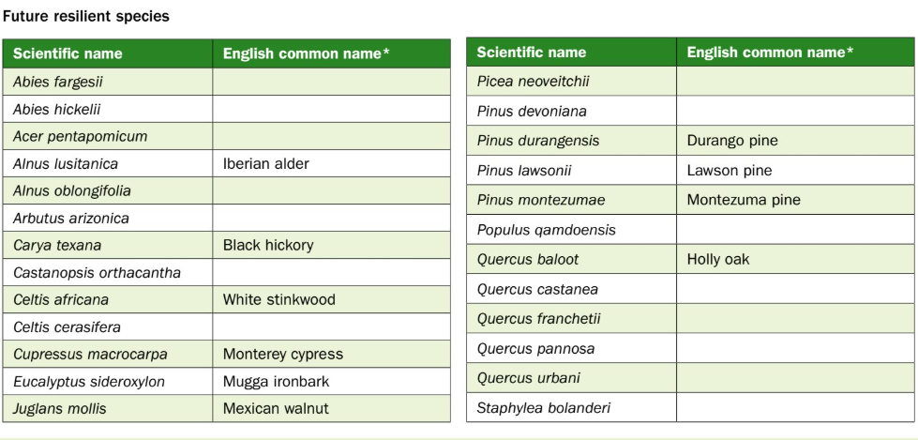
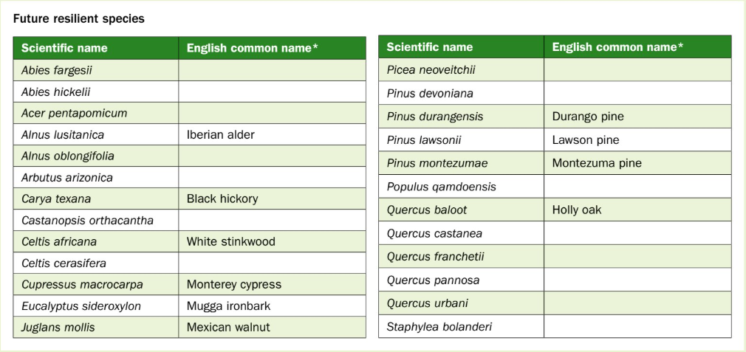

Slide 36
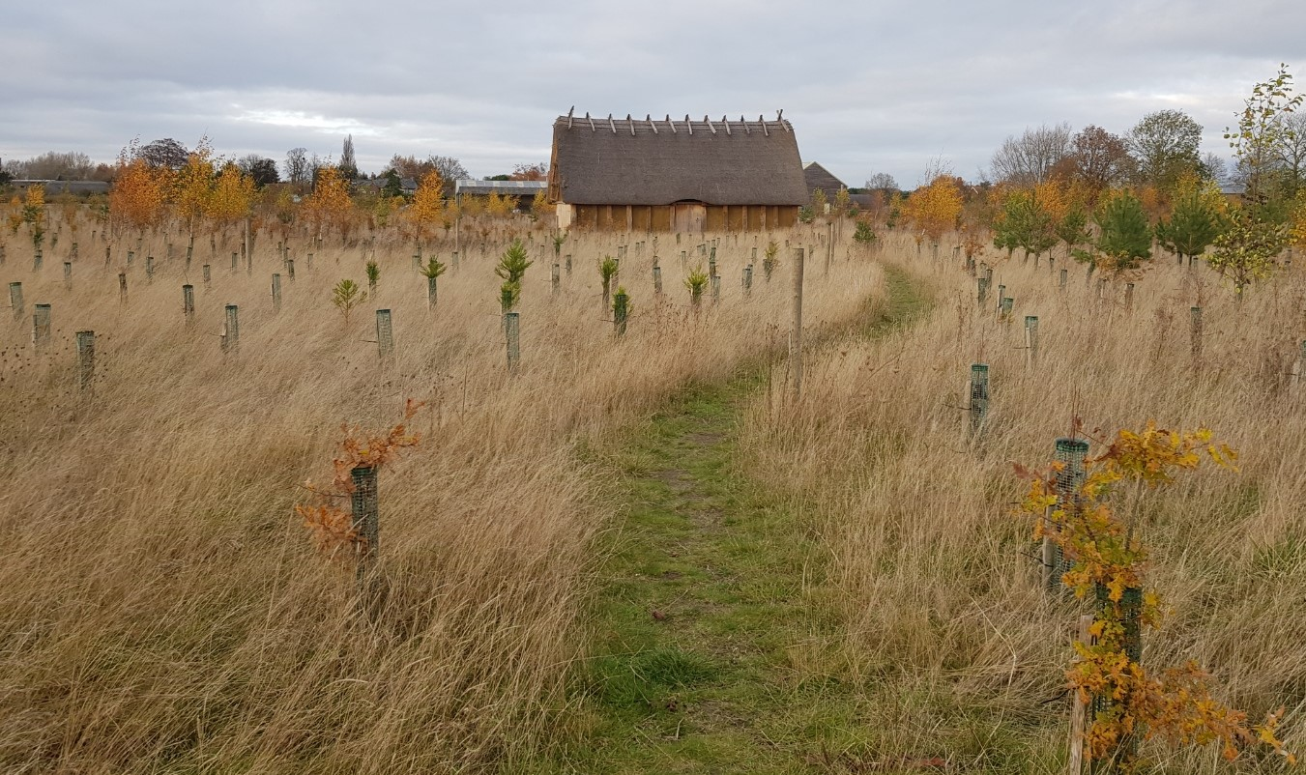
Sylva Future Forest
Notes:
If anyone is interested, at Long Whittenham they have planted a future forest at the Sylva Foundation, based on planting exotic, natives matched to our future climate, and native trees to understand how they perform.

Slide 37
Notes:
A useful tool to aid decision making when selecting the right tree for the right place is to use this useful online guide entitled Tree Species Selection for Green Infrraasture. A guide for specifiers The reason this guide is more beneficial than the traditional nursery catalogue is that science supports the charactiestics of each tree. For example the key characteristics that confer tolerance to environmental stress, which with more extreme weather on the horizon will be important factor to take into consideration when selecting appropriate trees.

Slide 38
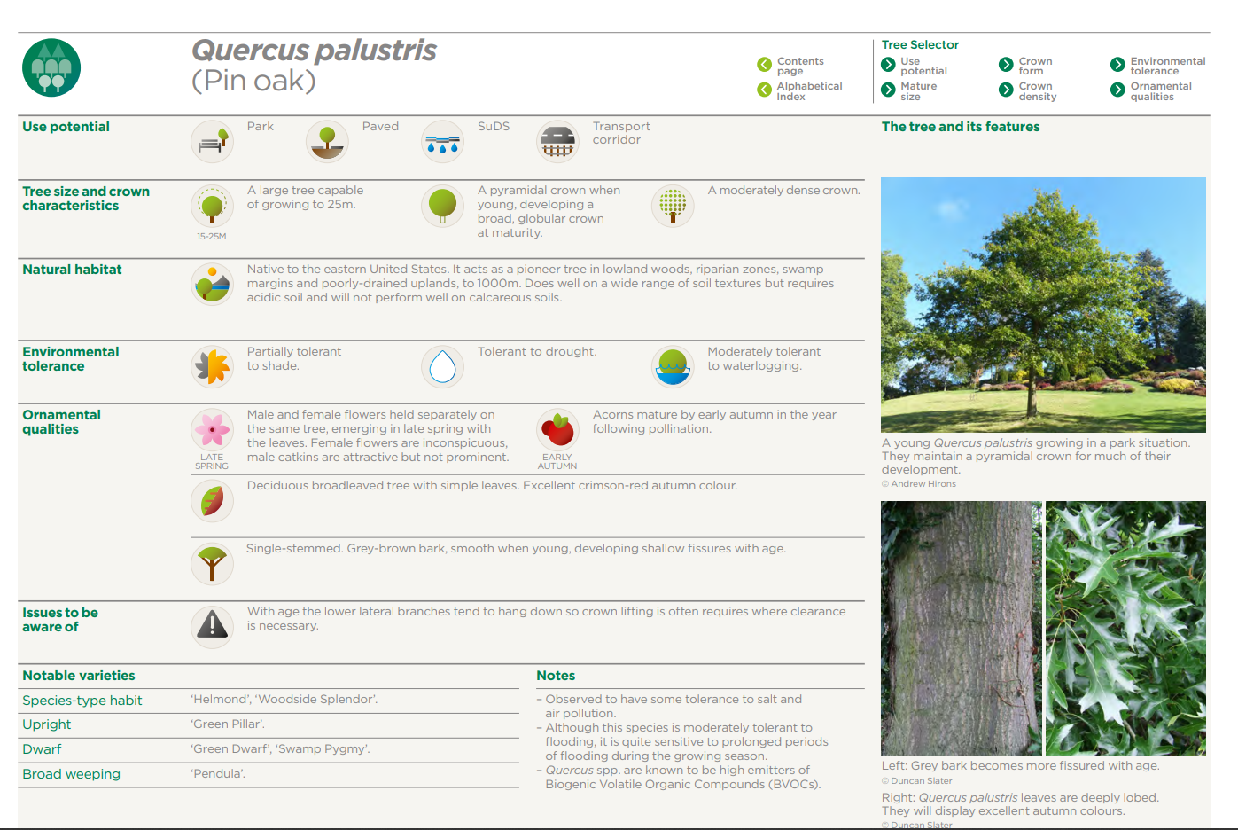
Notes:
So using this guide I have picked out some trees that I believe will be resilient for a changing climate.
Firstly, Quercus palustris as you can see from this slide it is tolerant to drought and is also moderately tolerant to waterlogging.
A further advantage of quercus palustris is that it is not a host for the oak processionary moth which both of our native oaks are.

Slide 39
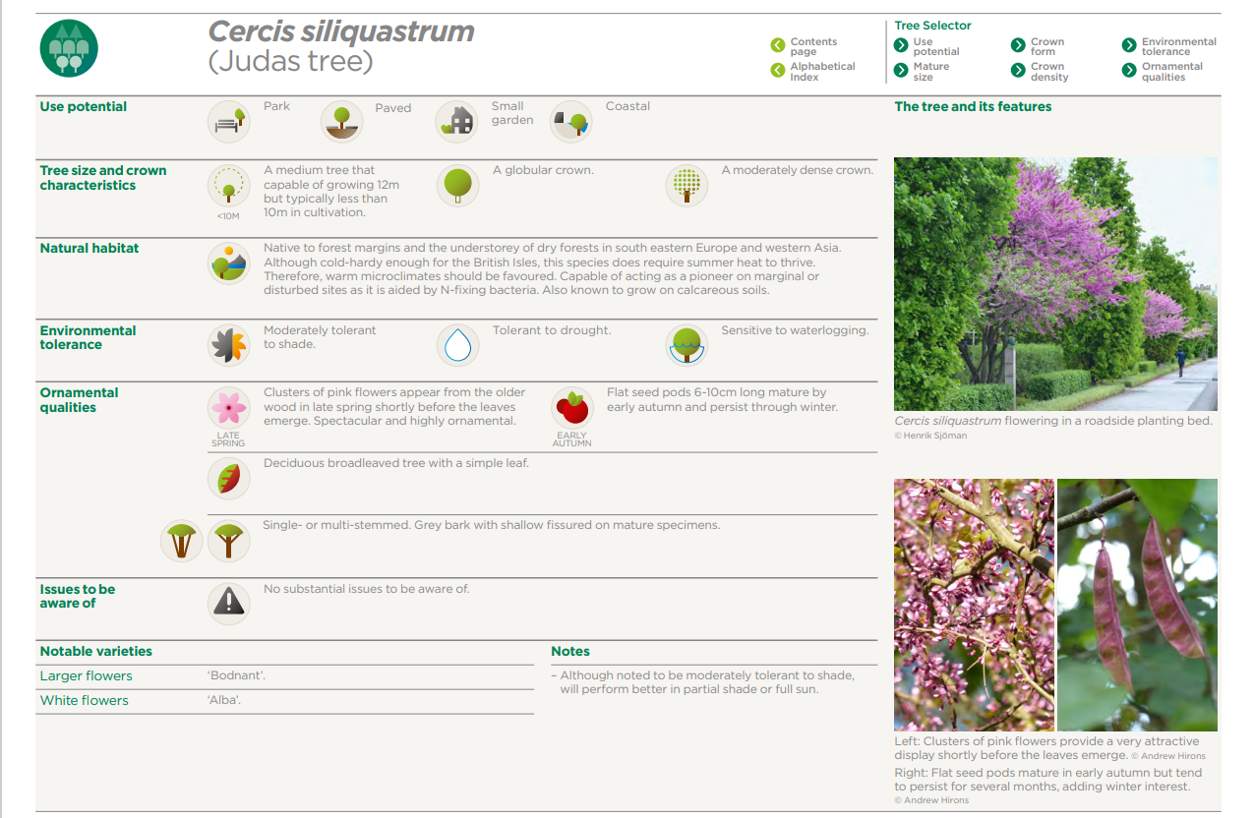
Notes:
Another good example of a drought tolerant tree is Cercis siliquastrum (Judas tree) which makes an excellent ornamental tree within the garden.

Slide 40
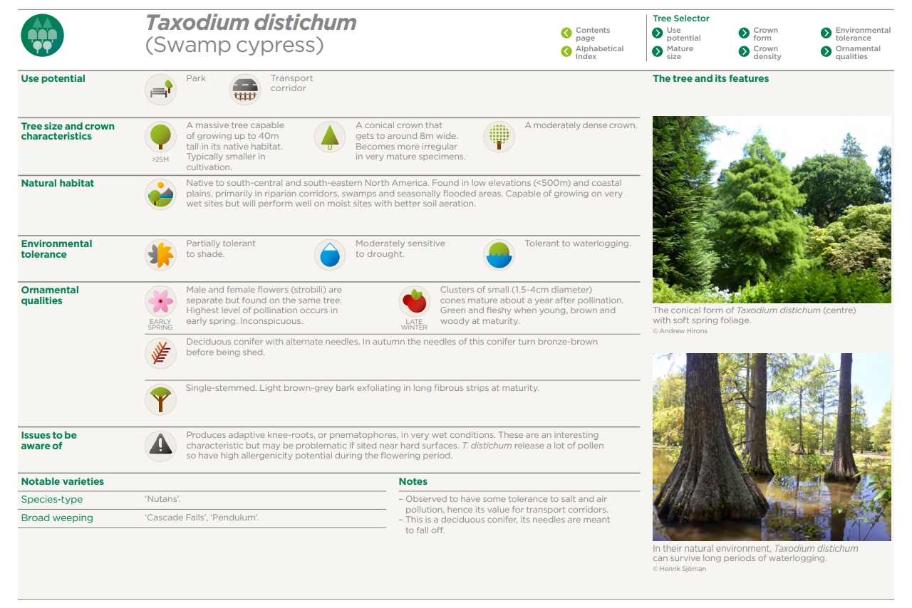
Notes:
Where you have a garden that is especially prone to waterlogging as it is near a spring or water course, then the Swamp Cypress is an ideal tree as it is physiologically adapted to be tolerant to waterlogging; that said you do need an especially large garden to accommodate this tree which can grow to a height of 40m.

Slide 41
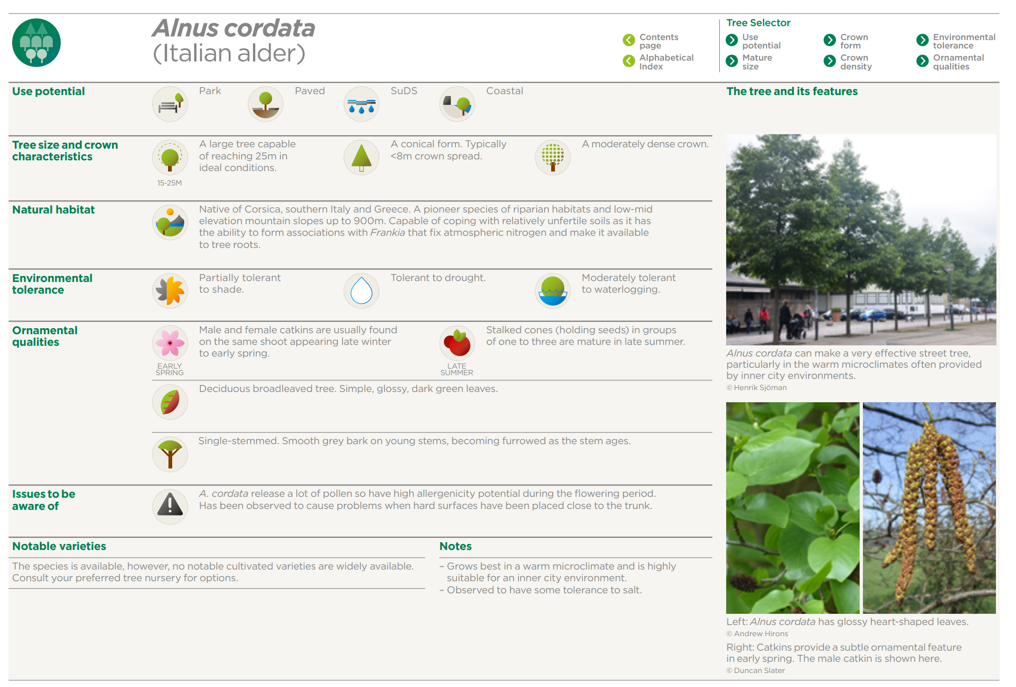

Slide 42
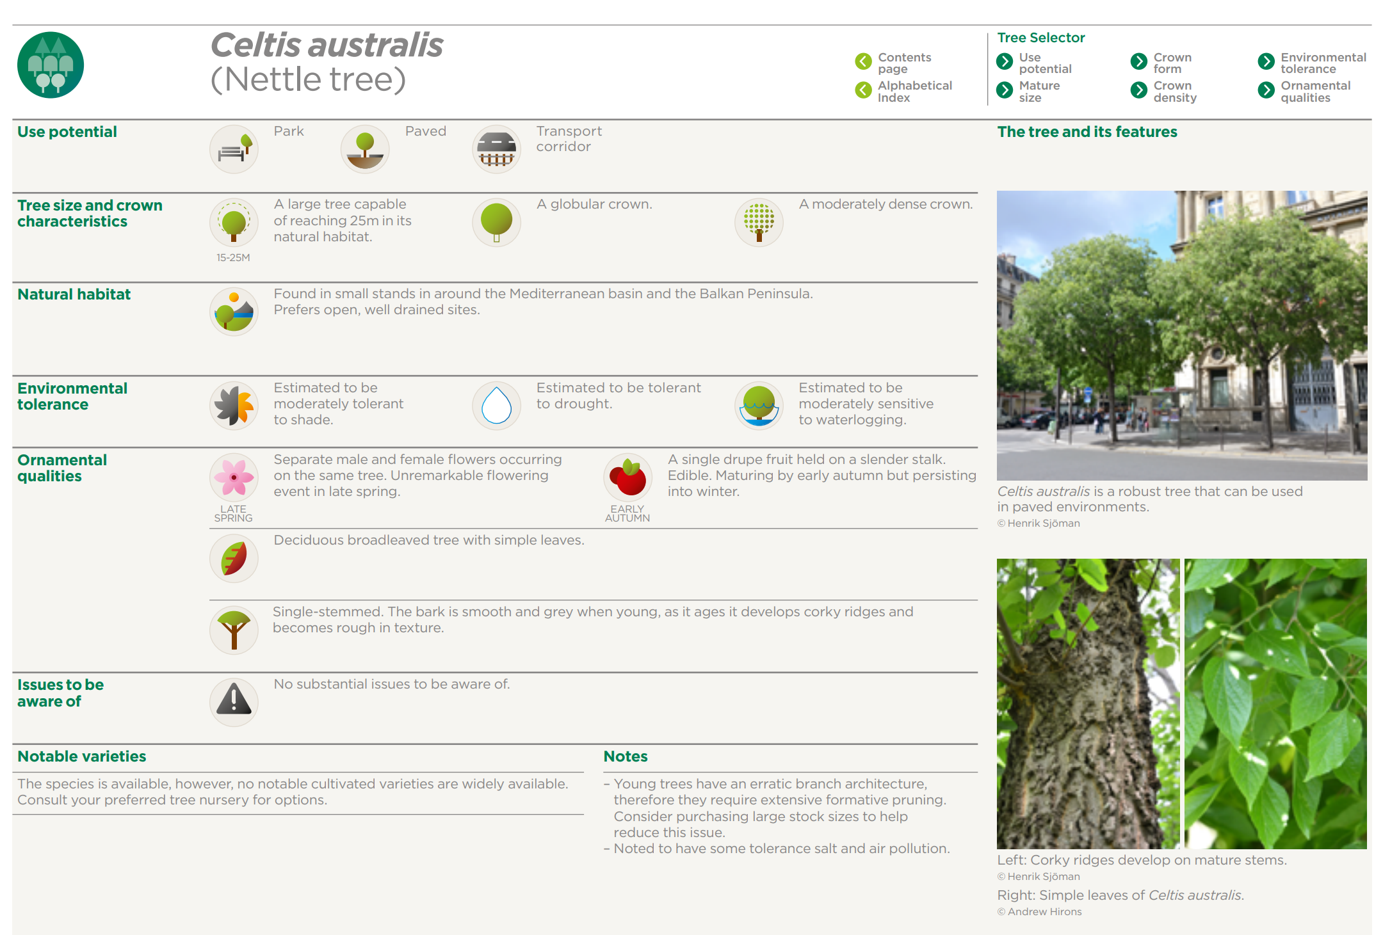

Slide 43
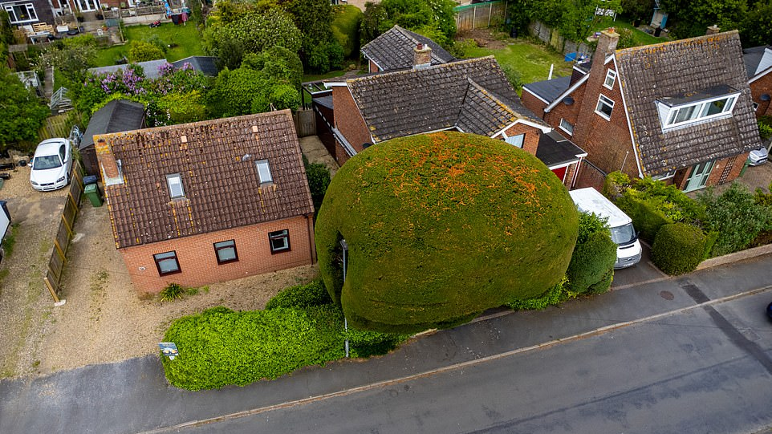
Selecting an appropriate tree for the right place!

Slide 44
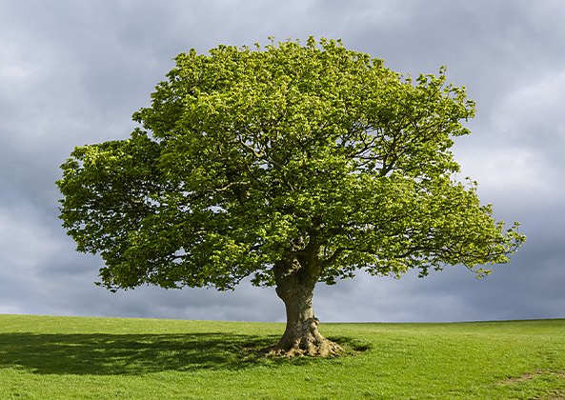
CONCLUSION
Trees will play a larger role in our landscape in the years to come.
Trees are not the solution to climate change but will help and they provide many other benefits to us, and wildlife.
Selecting the right trees to grow is critical
We need trees to thrive not just survive
AND so is planting a wide diversity of tree species

Slide 45
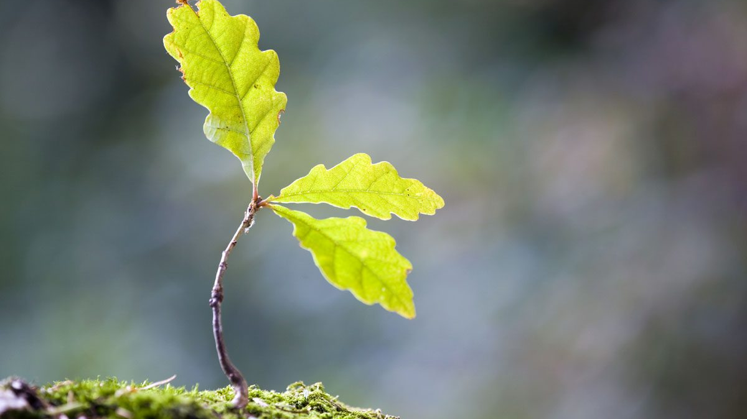
“The best time to plant a tree was 20 years ago. The second best time is now”
Chinese proverb
Notes:
So finally I encourage you all to go out a grow a tree as this famous Chinese proverb says

Slide 46
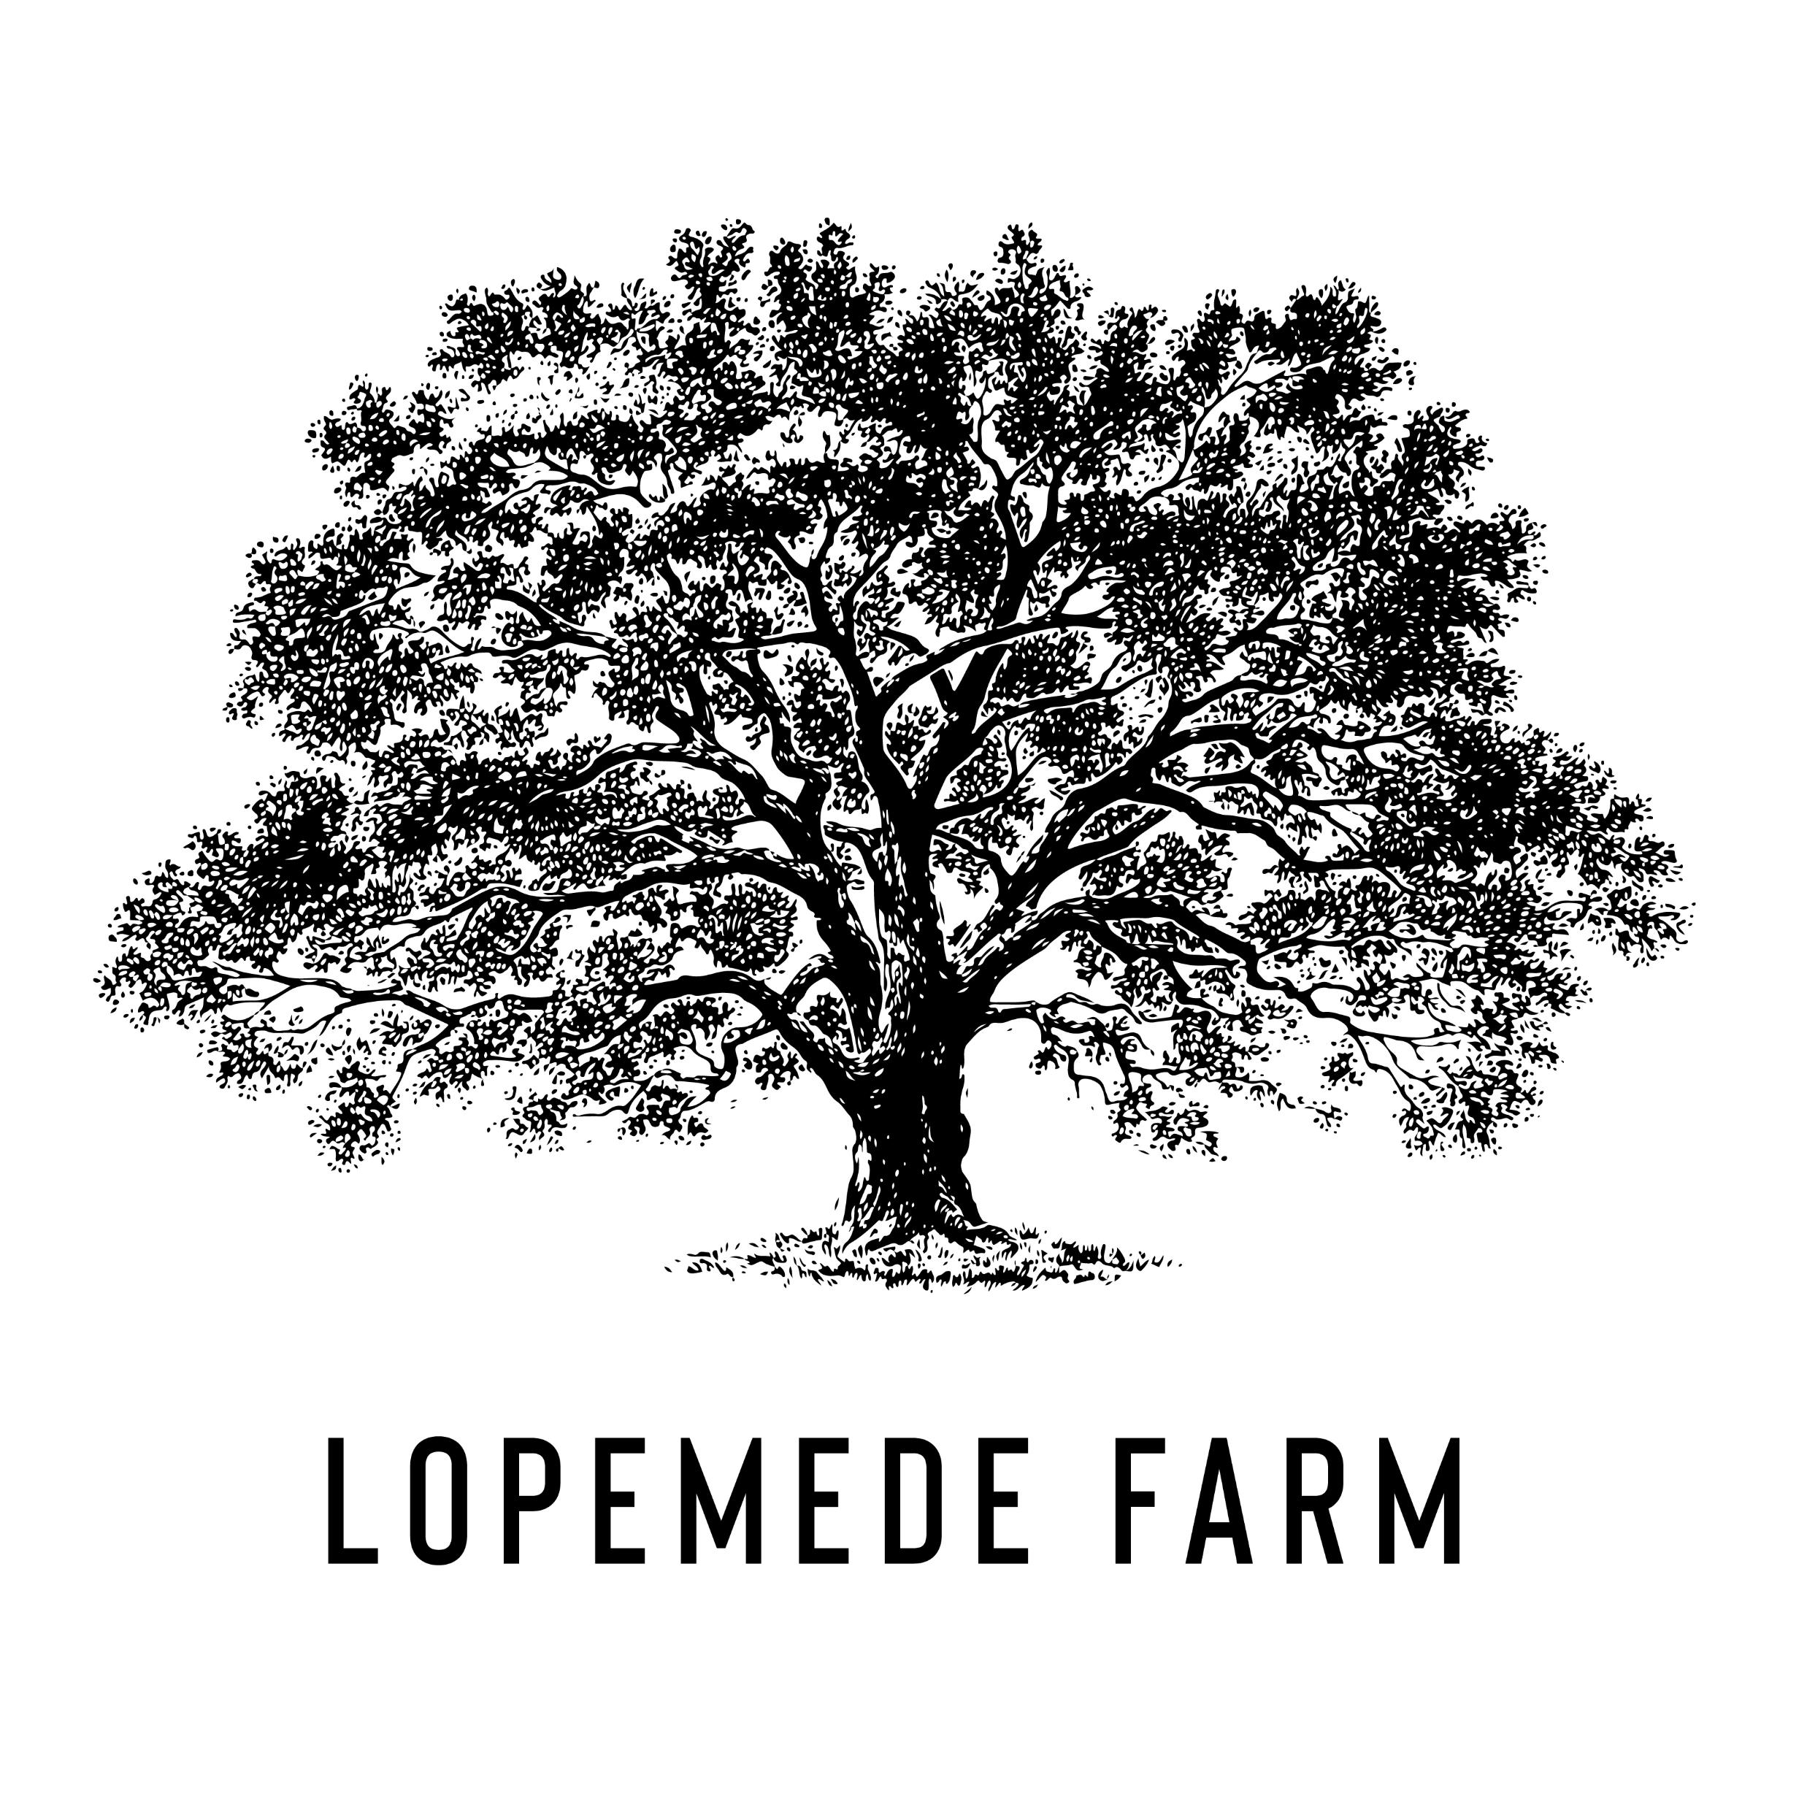
Questions

